Slide 1



人工智能
Harbin Engineering University
刘海波 沈晶

Slide 2
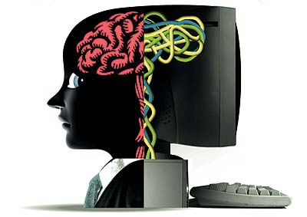
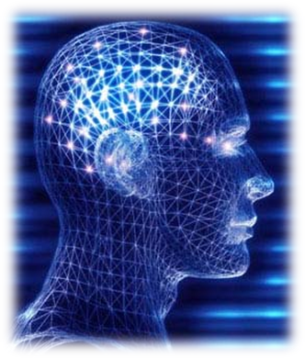
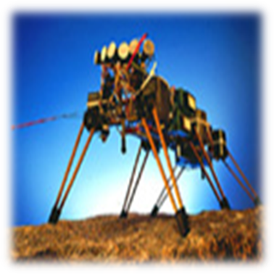

Review

Slide 3

Review

Slide 4

Review
Agent
Intelligent computer agents are both the original goal and the ultimate goal of artificial intelligence research.
--Hayes-Roth

Slide 5
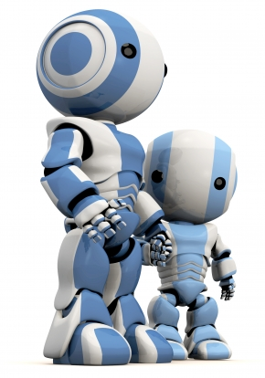

2 Agent

Slide 6

学习要求
能解释Agent的概念及特性
能列出Agent的心智要素并解释其含义
能列出Agent常用体系结构并解释其构成
能解释多Agent系统的概念及特性

Slide 7
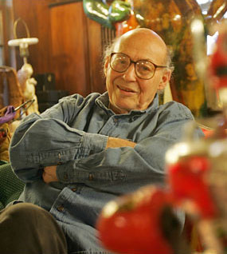
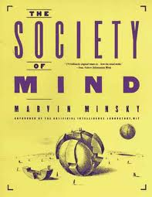
The Derivation of Agent
Agent一词源自拉丁语agere，意为“去做”
Agent作为AI术语始见于
Minsky于1988年出版的
The Society of Mind一书中
1994年万维网的出现推动了Agent技术迅速发展

Slide 8
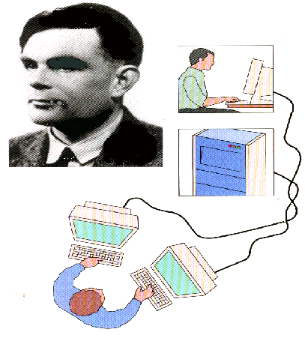
The Derivation of Agent
事实上，Turing Test已蕴含了Agent思想
Agent

Slide 9
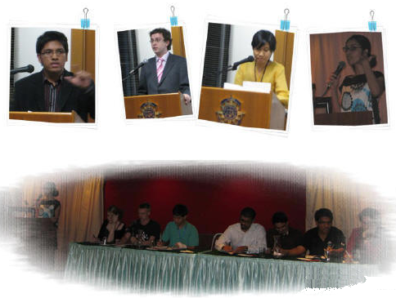
What is an Agent?
There are many different notions…

Slide 10

What is an Agent?
American Heritage Dictionary
  ... One that acts or has the power or authority to act... or represent another.

Slide 11

What is an Agent?
Jiming Liu and Jianbing Wu
  An autonomous agent is a computational system that acquires and analyzes sensory data or external stimulus and executes behaviors that produce effects in the environment.

Slide 12

What is an Agent?
Hayes-Roth
  Intelligent agents continuously perform three functions: perception of dynamic conditions in the environment; action to affect conditions in the environment; and reasoning to interpret perceptions, solve problems, draw inferences, and determine actions.

Slide 13

What is an Agent?
IBM
  Intelligent agents are software entities that carry out some set of operations on behalf of a user or another program with some degree of independence or autonomy, and in so doing, employ some knowledge or representation of the user's goals or desires.

Slide 14
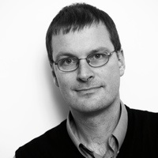
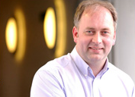
What is an Agent?
Weak notion
Wooldridge and Jennings
  An agent is a hardware or (more usually) software-based computer system that enjoys the following properties: autonomy, social ability, reactivity, pro-activeness.

Slide 15
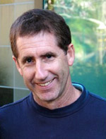
What is an Agent?
Shoham
  An agent is any entity whose state is viewed as consisting of mental components such as beliefs, capabilities, choices, and commitments.
Strong notion

Slide 16
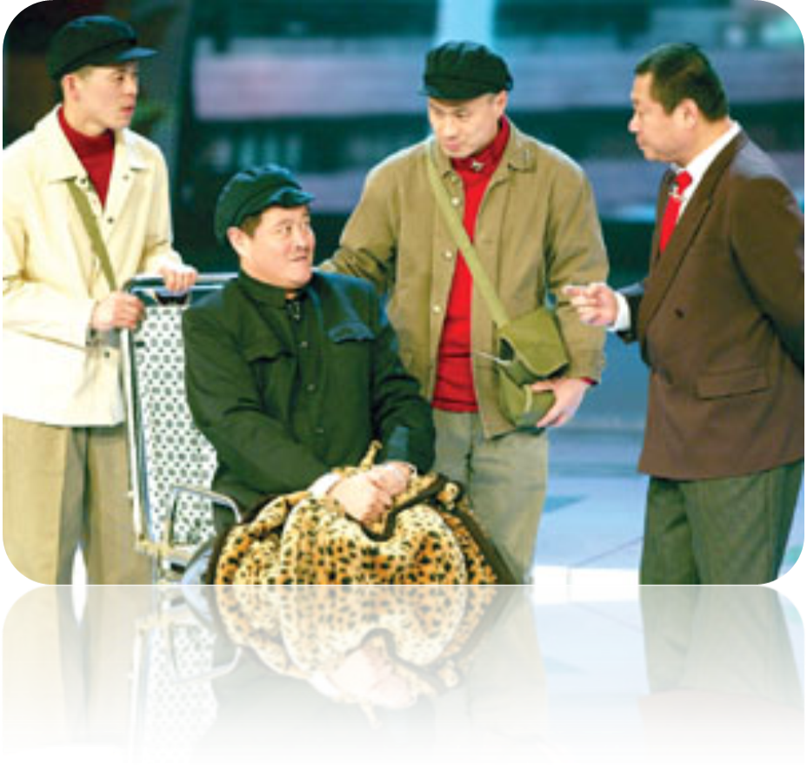
What is an Agent?
有点乱，捋一捋…

Slide 17
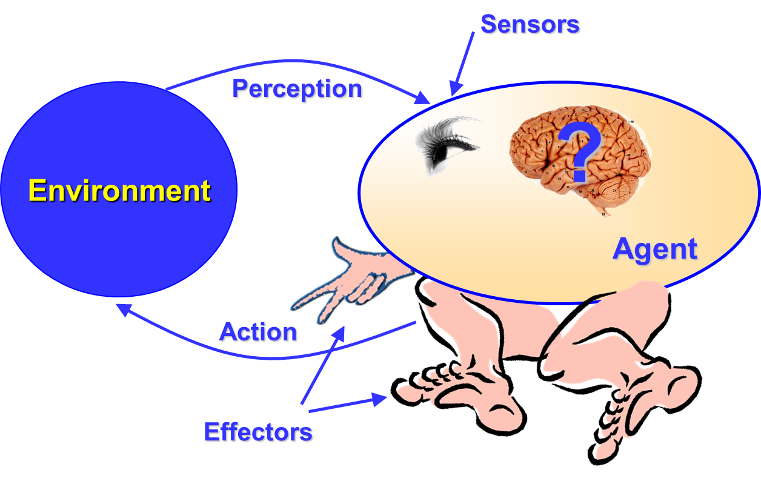
What is an Agent?
Real or virtual entity
Evolves in an environment
Is able to perceive this environment
Is able to act in this environment
Can communicate with other agents
Exhibits an autonomous behavior
Reactive or cognitive

Slide 18
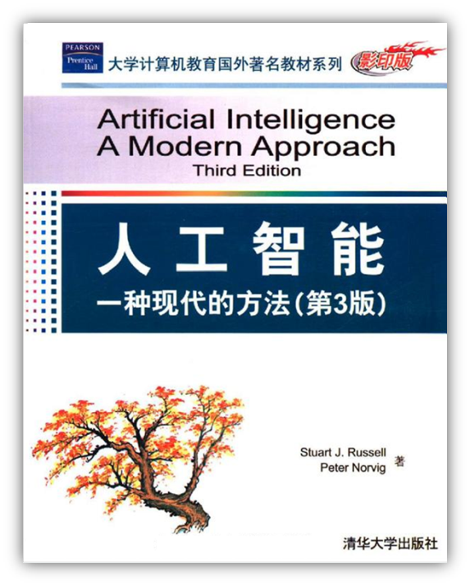
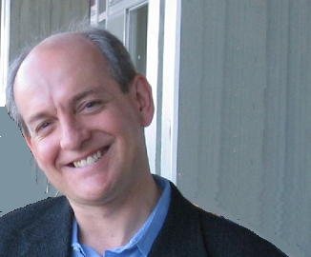
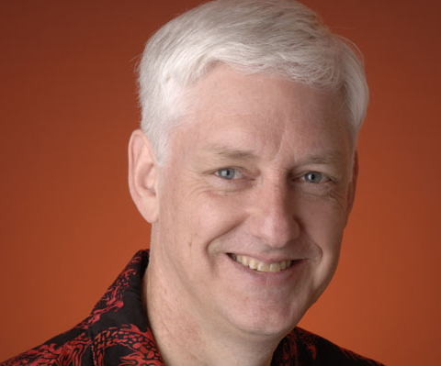
What is an Agent?
Russel and Norvig
  An agent is anything that can be viewed as perceiving its environment through sensors and acting upon that environment through effectors.

Slide 19
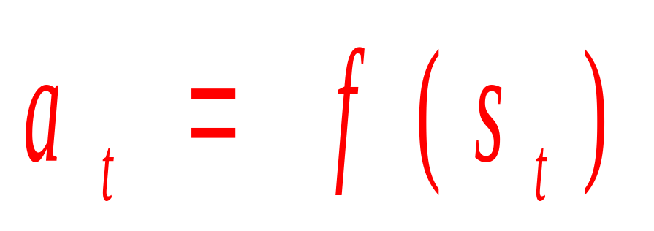
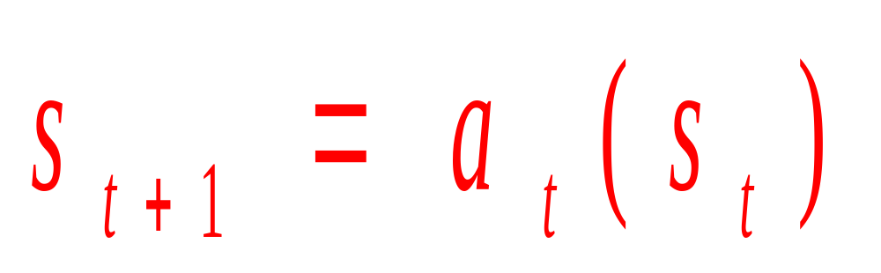
What is an Agent?

Slide 20
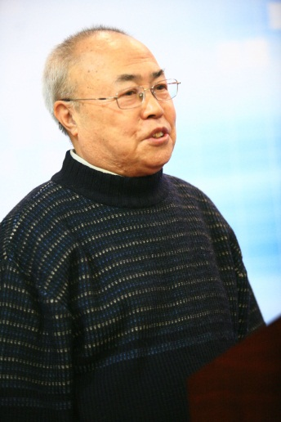

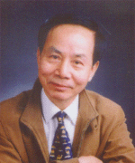
Agent in Chinese Literatures
Agent
智能体
主体
智能主体
代理
智能代理
艾真体
石纯一
史忠植
蔡自兴

Slide 21
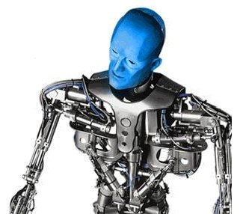
The Properties of Agents
Autonomy（自主性）
  Agents operate without the direct intervention of humans or others, and have some kind of control over their actions and internal state.

Slide 22
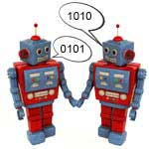
The Properties of Agents
Social ability（社会性）
  Agents interact with other agents (and possibly humans) via some kind of agent-communication language.

Slide 23
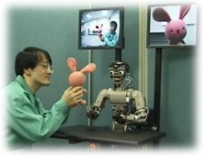
The Properties of Agents
Reactivity（反应性）
  Agents perceive their environment, (which may be the physical world, a user via a graphical user interface, a collection of other agents, the Internet, or perhaps all of these combined), and respond in a timely fashion to changes that occur in it.

Slide 24
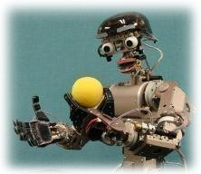
The Properties of Agents
Pro-activeness（主动性）
  Agents do not simply act in response to their environment, they are able to exhibit goal-directed behavior by taking the initiative.

Slide 25
The Attitudes of Agents
系统描述的几种立场
  Physical stance（物理立场）
  Design stance（设计立场）
  Intentional stance（意识立场）
意向立场
设计立场
物理立场

Slide 26
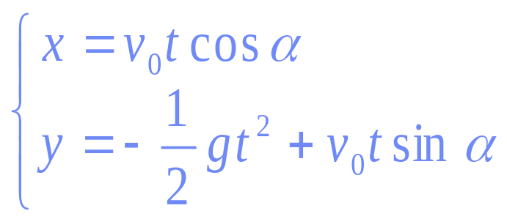
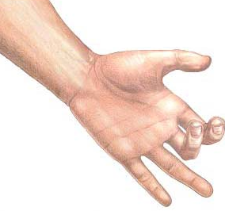
The Attitudes of Agents
物理立场
Y
v₀
如何描述抛出小球的运动规律？
α
X
描述简单的运动过程需要利用物理定律

Slide 27


The Attitudes of Agents
设计立场
如何描述钟表的运行规律？
1小时=60分钟
1分钟=60秒钟
描述复杂的机械运动需要考虑设计结构

Slide 28
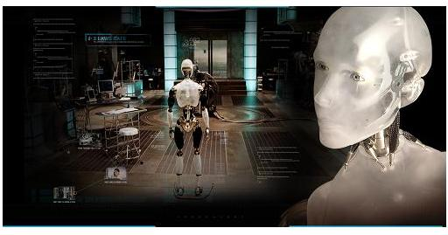
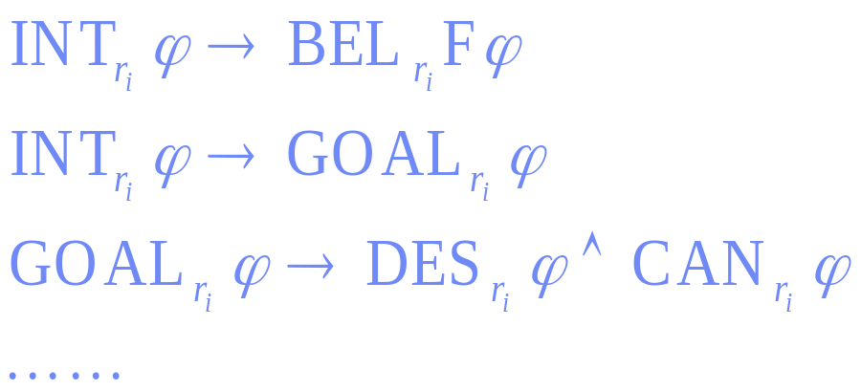
The Attitudes of Agents
意识立场
如何描述智能机器人的行为规律？
描述机器人的智能行为需要利用心智要素和逻辑工具

Slide 29
The Attitudes of Agents
心智要素
  认知：信念（Belief）、学习、知识等
  情感：愿望（Desire）、偏好、兴趣等
  意向：意图（Intention） 、目标、 承诺等
BDI
  1987年哲学家Bratman提出实用推理理论，特别强调了意图的作用，他认为只有信念、愿望、意图的理性平衡，Agent才能有效地解决问题。
  Rao和Georgeff等用模态逻辑来描述BDI模型。

Slide 30
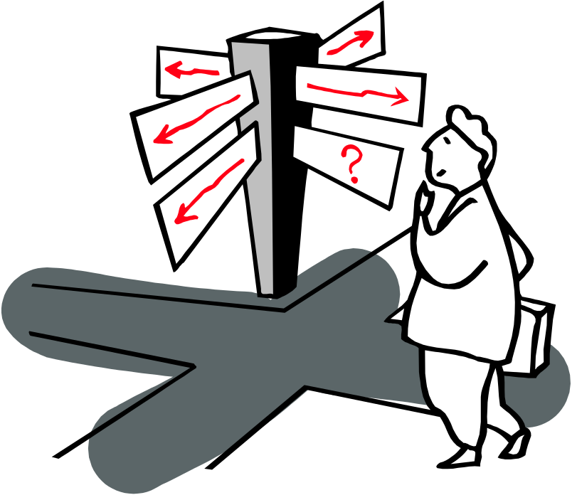
The Attitudes of Agents
意图的作用
  驱动目标规划
  引发持续努力
  约束行为选择
  影响未来信念

Slide 31
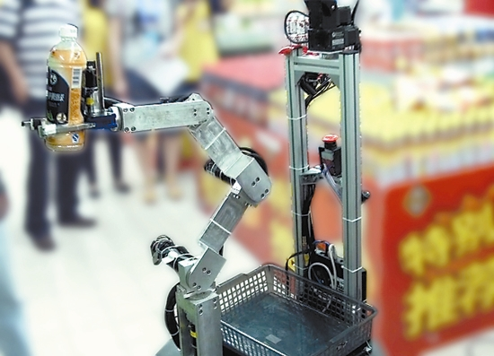
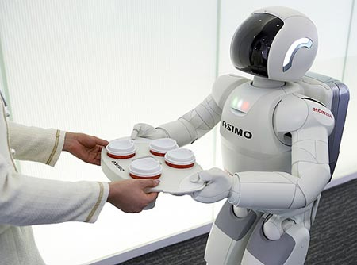
The Attitudes of Agents
承诺策略（Commitment Strategies）：
  盲目承诺（Blind commitment）
  专心承诺（Single-minded commitment）
  开明承诺（Open-minded commitment）
Notes:
左图为中科大开发的家用机器人“可佳”，在2011全国机器人大赛的特殊赛场——兰州市安宁区的一家超市里表演超市购物。
右图为日本本田公司开发的Asimo家用机器人。

Slide 32


Rational Agent
理性（rationality），即在所知范围内正确行事（right function），那么何为“正确行事”？
A rational agent chooses whichever
action maximizes the expected value
of the performance measure given
the percept sequence to date.

Slide 33
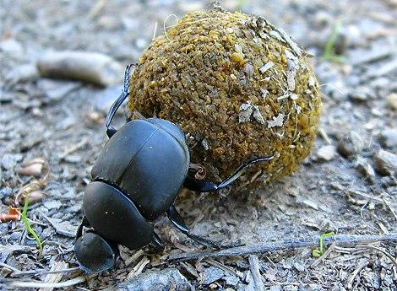
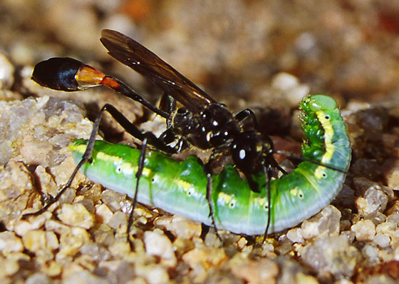
Rational Agent
Rational(理性的)≠Omniscient(全知的)
Rational →Exploration, Learning, Autonomy

Slide 34
Agent vs. Object
Agents are autonomous
Agents are smart
Agents are multi-threaded
Object
Agent

Slide 35
The Architectures of Agents
Maes defines an agent architecture as a particular methodology for building agents. It specifies:
  how the agent can be decomposed into the construction of a set of component modules
  how these modules should be made to interact

Slide 36
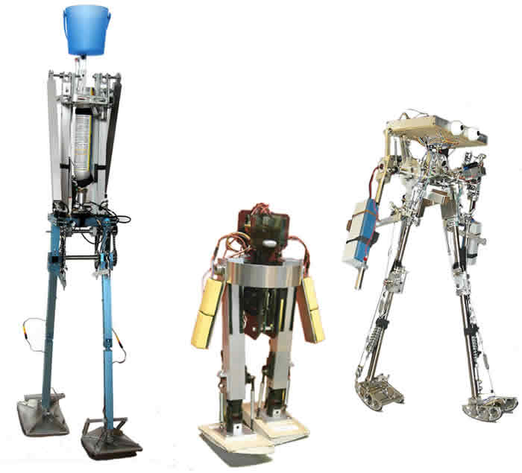
The Architectures of Agents
Agent = Architecture + Program
Traditional AI

Slide 37
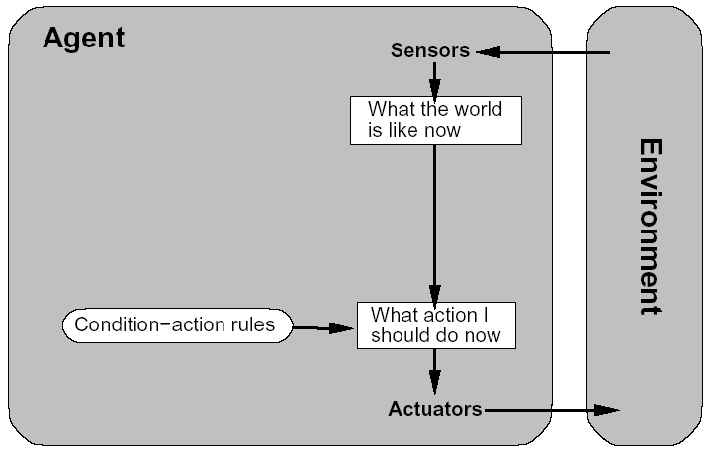
The Architectures of Agents
Simple Reflex Agent

Slide 38
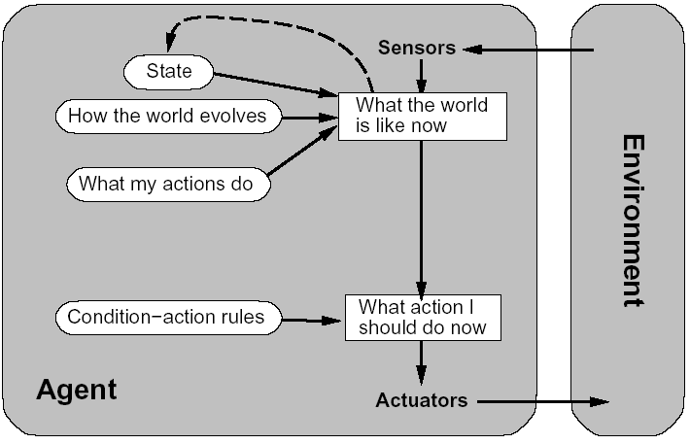
The Architectures of Agents
Model-based Reflex Agent

Slide 39
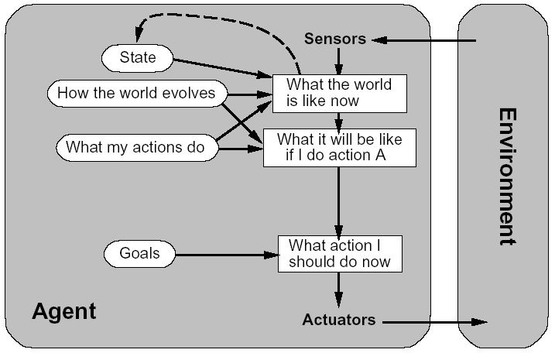
The Architectures of Agents
Goal-based Agent

Slide 40
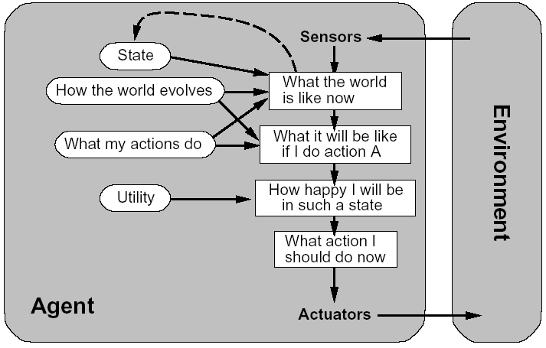
The Architectures of Agents
Utility-based Agent

Slide 41
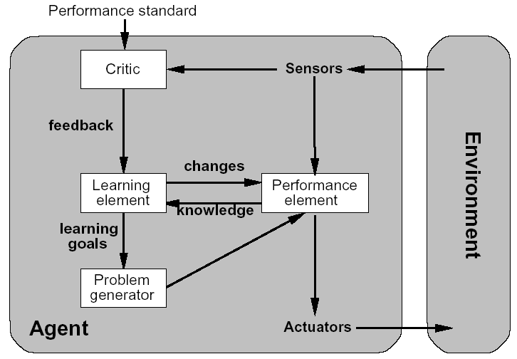
The Architectures of Agents
Learning Agent

Slide 42
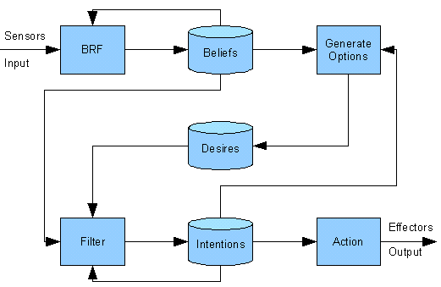
The Architectures of Agents
BDI Agent

Slide 43
Multi-Agent System
A multi-agent system (MAS) is one that consists of a number of agents, which interact with one-another.
The characteristics of MASs are that
  each agent has incomplete information or capabilities for solving the problem and, thus, has a limited viewpoint;
  there is no system global control;
  data are decentralized;
  computation is asynchronous.

Slide 44
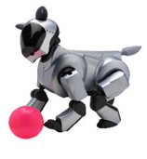
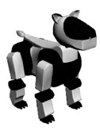
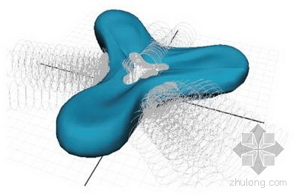
Multi-Agent System
The Main Topics about MAS
  Communication
  Organizational Architecture
  Cooperation/Coordination

Slide 45
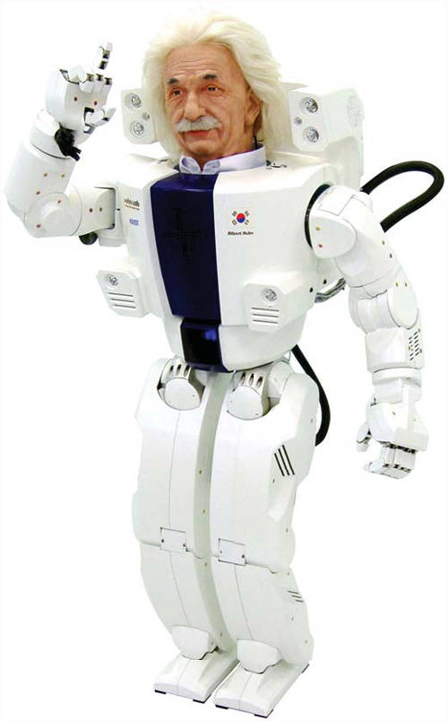
Questions
Agent和人有什么区别？

